Slide 1
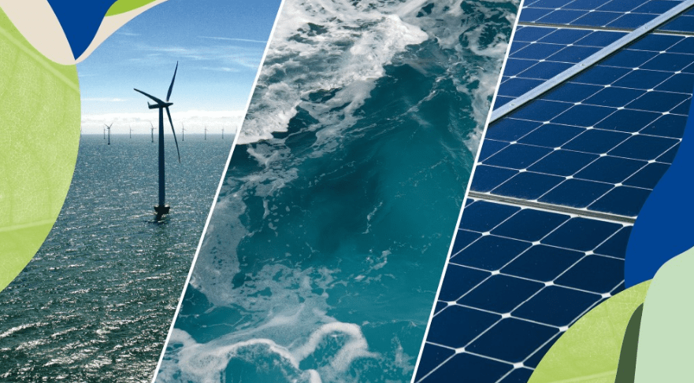
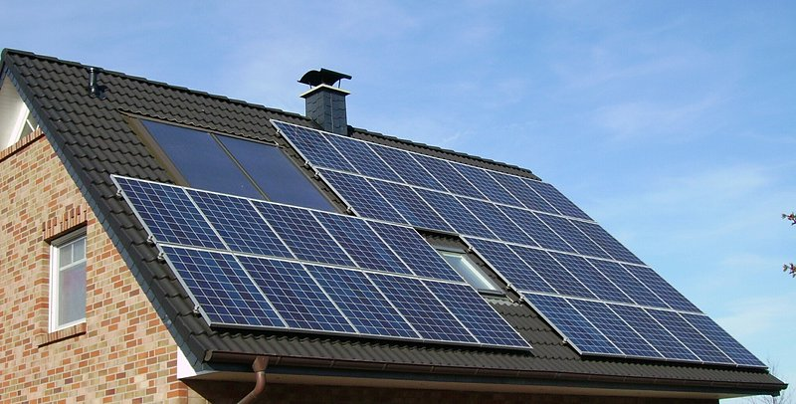
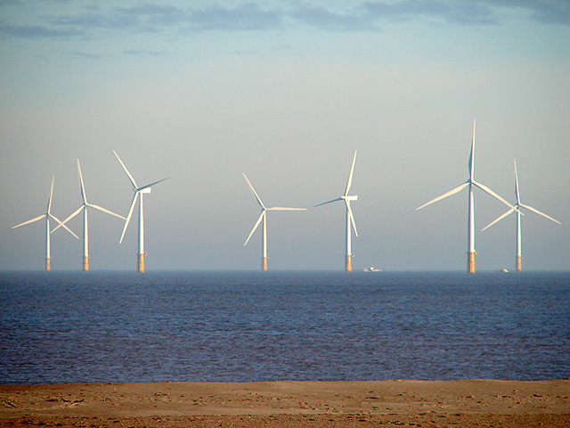
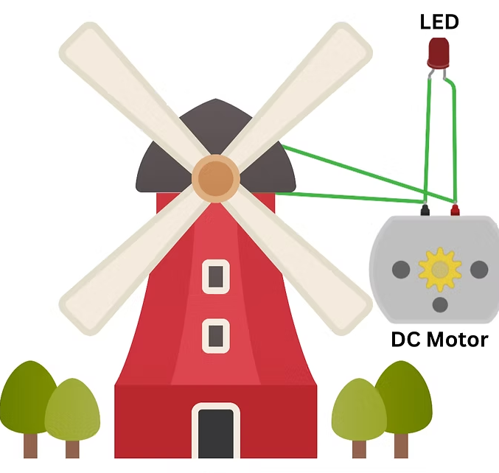
Oak Class Home Learning
Our topic this term is ‘Natural Resources.”
Research about the Boston Fishing Fleet?
Ideas could be to answer…
How many Boats they have?
What types of fish they catch?
Where they go?
Make a poster about renewable energy.
Make a windmill that lights a bulb!
Where does our area get its power?
Write a list of all the types of energy that are used in the area
Where they are
What they provide.
Which are renewable sources.
How could we improve our power providers.
anything else that you could discover.
Design an energy saving house using different sources
Wind-Powered LED: Build Your Own Windmill Project!

