Slide 1
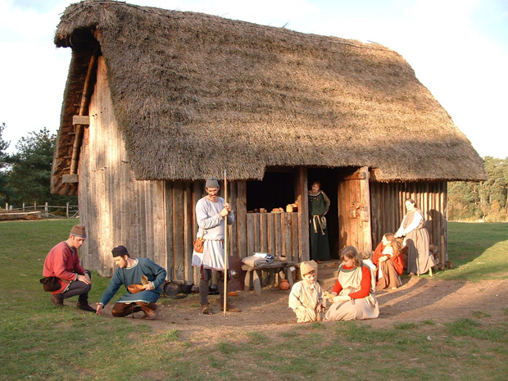

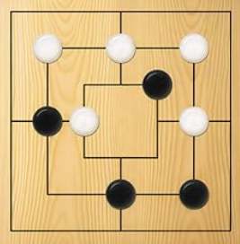
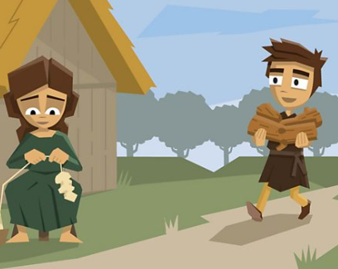
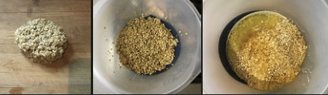
Oak Class Home Learning
Our topic this term is ‘Why did the Anglo-Saxons want to settle in Britain?
Rune Bookmarks
Use a rune alphabet guide to write names in Anglo-Saxon script on card, adding colour and ribbon.
Write me a story about a Saxon girl/boy landing in Lincolnshire and settling in Wrangle.
Roundhouse Models
Build thatched models of a Saxon wooden building
Make traditional oatcakes using porridge oats, butter, dried fruit, and honey, as described in this Kids Rule! TV episode.
Board Games: Learn to play simple, historical games like Nine Men's Morris or games with dice and counters.
Time-Travel Diary: Write a diary entry detailing a day in an Anglo-Saxon village, including cooking, farming, or hearing stories.

Slide 2

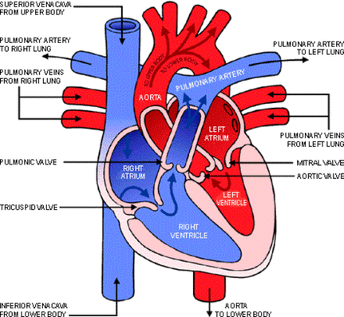

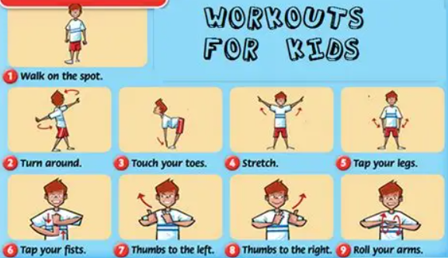
Oak Class Home Learning
Our topic this term is ‘Why is a healty heart important?”
Research what a heart does?
Its purpose and the flow of blood around the body.
Make an exercise diary
Write a list of all the exercise you get in one week. This could include:
walking, cycling, skating or scooting to school
PE lessons
active games at playtime
activities like swimming, football clubs or dancing
anything else that gets your body moving and makes you heart rate increase
Make fruit kebabs and design a healthy heart menu.
Make a poster of how to keep your heart healthy.
Make a workout routine and video to share with the class.

